Slide 1
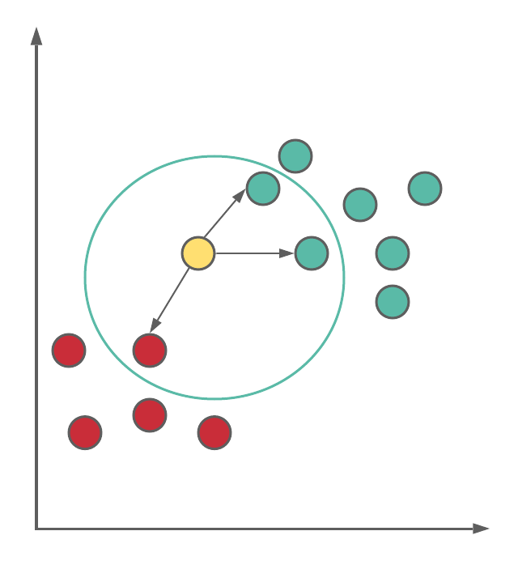
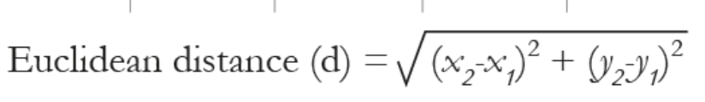
KNN Classifier

Slide 2
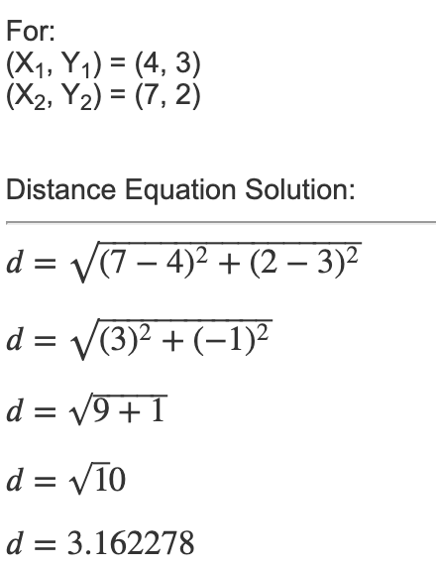
Query => x = (DS = 7, Maths=2) , k(No of neighbours) = 3
Data Structures | Maths | Result
4 | 3 | Fail
6 | 7 | Pass
7 | 8 | Pass
5 | 5 | Fail
8 | 8 | Pass

Slide 3
Query => x = (DS = 7, Maths=2) , k(No of neighbours) = 3
Data Structures | Maths | Result
4 | 3 | Fail
6 | 7 | Pass
7 | 8 | Pass
5 | 4 | Fail
8 | 6 | Pass
(X1, Y1) | (X2,Y2) | d
(4,3) | (7,2) | 3.16
(6,7) | (7,2) | 5.09
(7,8) | (7,2) | 6
(7,4) | (7,2) | 2
(8,6) | (7,2) | 4.12

